Slide 1
7FNCE040W
Business Analytics

Slide 2
Materials used in this module
Standard Essential Textbook
SPSS manual
R training -optional
Data sets for illustration of techniques.

Slide 3
Assumption of students abilities
Computable with Basic mathematical concepts we do not assume a graduate degree in mathematical science.
Don’t use matrix algebra on this module.
Assume students are interested in applying statistical learning methods to real world problems to facilitate this a section in each chapter of the text book will be dedicated to all computer labs.
This works through a realistic application of the methods considered.
Note the labs are self contained and can be skipped if the student wishes to use a different software package or does not wish to apply the matters discussed to real world problems We will use SPSS

Slide 4
Statistical learning
What Is it ?
refers to a vast set of tools for understanding data.
Classified as supervised or unsupervised
Supervised involves building statistical models for predicting output using one or more inputs e.g. Regression models – wages vs age ,edu, yr in company. Predicting a continuous or quantitative output value
Unsupervised has inputs but no supervising outputs (learn from relationships and structure from such data)

Slide 5
Stock Market Data E.g. Classification problem. Several methods can lead to correct prediction of direction of the market movement at least 60% of the time
Notes:
Use Smarket data –box plots of previous day’s % change box plot may show no change initially but can use several statistical methods ( correctly predict the direction of the market movement at (60% of time)
Predict a non numerical value stock market ( categorical or qualitative output) For example we examine stock market data set contains S & P 500 stock index from 2001 to 2005.
The objective is to predict weather the index will increase or decrease on a given day using the past five day percentage change in the index here we're predicting whether a given day stock market performance will fall into the up bucket or a down bucket this is known as a classification problem Quadratic discriminant analysis see fig 1.3 Predicted probability off decreased market this hard the direction of the more movement in the market 60% of the time

Slide 6
Quadratic discriminant analysis
Notes:
classification problem Quadratic discriminant analysis see fig 1.3 Predicted probability off decreased market this showed the direction of the movement in the market correctly 60% of the time

Slide 7
Clustering Methods
Here we may only have input variables
e.g. In marketing we may have demographic information potential customers wish to understand which type of custom customers are similar to each other why grouping individuals according to their observed characteristics this is known as clustering problem note we are not trying to predict an output variable – just to identify ‘clusters’
We are interested in determining whether there are groups or clusters based on their measurements characteristics _ Ch 10.
One technique commonly used is called Principle Component Analysis

Slide 8
Clustering method diagram

Slide 9
Predicting Qualitative values
Linear Discriminant analysis or an alternative approach is Logistic regression
Since 1986 Machine learning and other disciplines has resulted in statistical learning emerging as a new subfield in statistics
Focused on Supervised and unsupervised modelling and prediction.
In recent years progress in statistical learning has been marked by the increasing availability of powerful and relatively user friendly software such as ‘R’ system. This has the potential to transform the field from a set of techniques used and developed by statisticians and computer scientists into essential toolkit for a much broader community

Slide 10
What is Statistical Learning
Examples Impact of Advertising affecting Sales
Advertising Budget = input variable ( independent variable/s) others can be TV adverts , newspapers adverts always on x axis
Sales = response variable ( dependent variable ) –what are we trying to forecast? Always on y axis.
Objective If there is an association between x and y develop a model to predict sales on the basis of the three advertising budgets.
Y = f(x) + e

Slide 11
Simple relationships Income vs Education - Regression

Slide 12
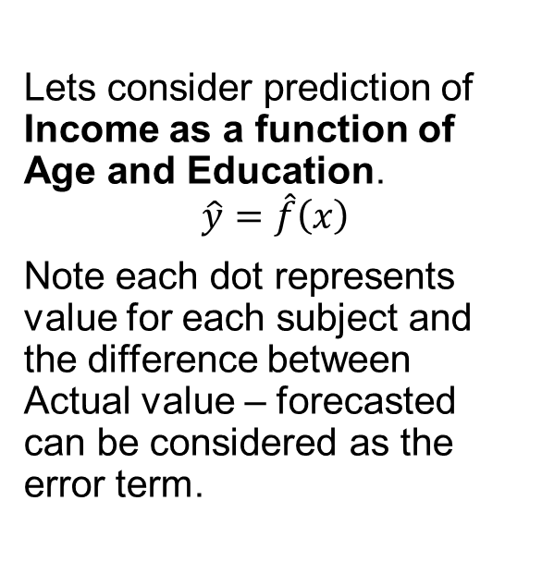
Chapter 2 of core text bk Why estimate f? 1. Prediction 2. Inference
Lets consider prediction of Income as a function of Age and Education.
$$\hat{y}=\hat{f}\left(x\right)$$
Note each dot represents value for each subject and the difference between Actual value – forecasted can be considered as the error term.
Notes:
In situations , where sets of x inputs are readily available we can use these to predict Y using the formula Y hat equals function of x. This allows us to predict Y for given values of x . Here function of Y is regarded as a black box stop

Slide 13
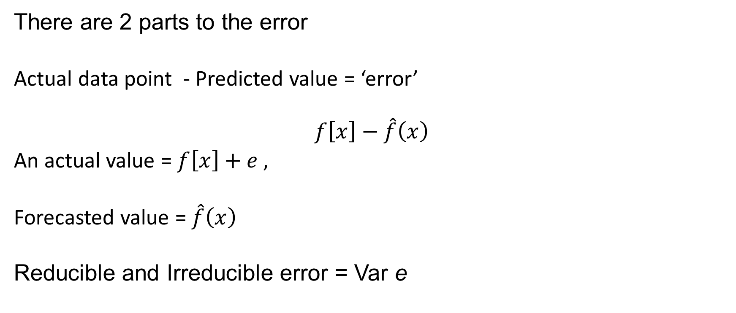
Errors in predictions
There are 2 parts to the error
Actual data point - Predicted value = ‘error’
$$f\left[x\right]−\hat{f}\left(x\right)$$
An actual value = $f\left[x\right]+ⅇ ,$
Forecasted value = $\hat{f}\left(x\right)$
Reducible and Irreducible error = Var e
Notes:
Reducible error is the difference between an actual point and the forecasted value squared..{actual point – forecasted value} ^ 2
Irreducible error = variance of e

Slide 14
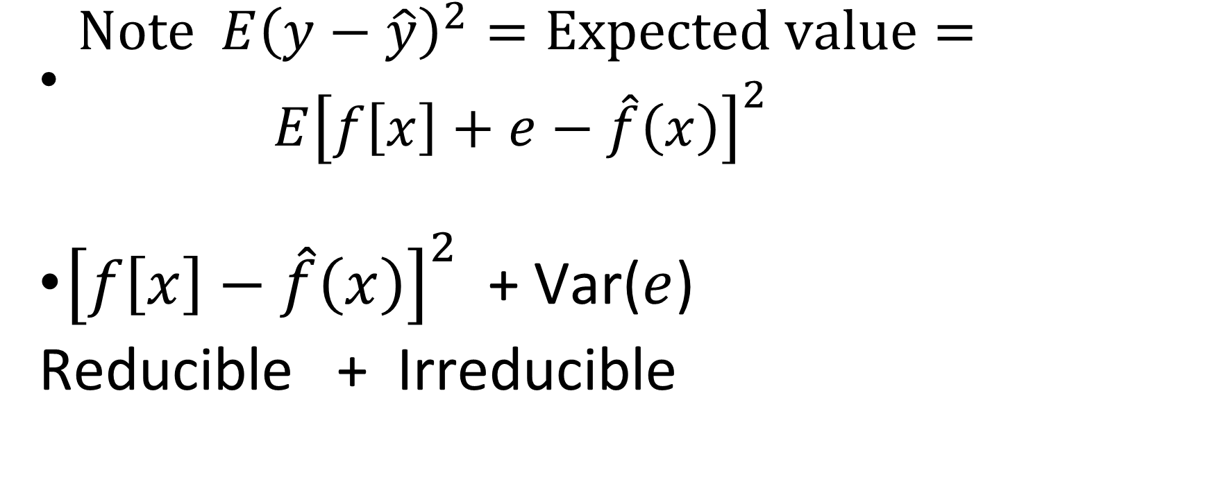
1. Prediction errors Our Aim is to minimise the Reducible error
$\begin{matrix} Note E{\left(y−\hat{y}\right)}^{2}=Expected value= \\ E{\left[f\left[x\right]+ⅇ−\hat{f}\left(x\right)\right]}^{2}\end{matrix}$
${\left[f\left[x\right]−\hat{f}\left(x\right)\right]}^{2}$ + Var($ⅇ$)
Reducible + Irreducible
Notes:
No matter how well we forecast y, we cannot reduce the error introduced by e. Note e will always provide an upper bound on the accuracy of our prediction for Y. This bound is almost always unknown in practice.

Slide 15
Inference Only interested in understanding the way the dependent variable Y is affected as X1… Xp changes
Goal is not to make predictions for Y but to understand the relationship between X&Y how it changes as a function of X1..Xp . Here we cannot treat this equation as a black box. In this situation we may be interested in answering the following questions
1 which predictors are associated with the response?
2 what is the relationship between the response and each predictor?
3 can the relationship between Y and each predictor be adequately summarised using a linear equation, or is the relationship more complicated?
Notes:
This introduces the technique of Multiple Regression which we can cover later in the module.
Example may be considering factors which affect sales vs advertising spend , experience of sales person etc..

Slide 16
What is our goal ? Prediction or Inference or both?
Linear models are simple
But Non Linear may be more accurate ( we will visit these later)
In part 2 of lecture we will build a simple and multiple regression model using SPSS
Notes:
linear models allow for relatively simple interpretable inference but may not yield as accurate predictions as some other approaches. In contrast some of the highly non linear approaches can potentially provide quite accurate predictions for Y but this comes at the expense of a less interpretable model for which inference is more challenging.

Slide 17
Using the data set ‘Income2.xls ‘ in excel
Plot scatter diagram to see how each variable is linked to income
Income vs Education
Income vs seniority
Fit a line of best fit to one relationship and estimate errors.
If you are happy with this try looking at the data last week in ‘National Insurance.xls’ and identify which factors affect the income of respondents in the survey – use spss to carry out this analysis.

Slide 18
10 minutes break

Slide 19
Supervised Verse Unsupervised Learning
The examples used in this section all fall under the supervised learning domain.
As Each observation of the predictor measurement has an association with the response measurement y.
We fit a model that relates the response with the aim of accurately predicting this response for future observations or better understanding the relationship between the response and the predictors (inference)
Classical statistical methods such as linear regression and logistic regression and other modern approaches operate in the supervised learning domain.
In contrast unsupervised learning describes more challenging situations in which for every observation i, we observed a vector of measurement Xi but no associated response y. It is not possible to fit a linear regression model since there is no response variable to predict. In some sense we are working blind Eg cluster analysis used for market segmentation.

Slide 20
Lecture 1 Bite 2 continued
Open the Advertising data file in spss
(This situ is an inference paradigm)
Management may be considering the following questions
Which media contribute to sales?
Which media generate the biggest boost in sales? Or
How much increase in sales is associated with a given increase in TV advertising?
Notes:
Inference paradigm
Another e.g. how variables such as price , location of store competitor’s price etc may affect the probability of purchasing a particular product?
Some modelling could be conducted for both inference and prediction – e.g. Real estate eg- how much EXTRA is a house worth if it overlooks a lake? - = inference problem but if are interested in predicting the value of a given its characteristic is it over or under priced? == Prediction problem.

Slide 21
Inference vs Predictions
Linear models allow for easy interpretation – may not lead to accurate predictions
Non – linear models approached considered later in the module can potentially provide more accurate predictions for Y ( but can be less interpretable)

Slide 22
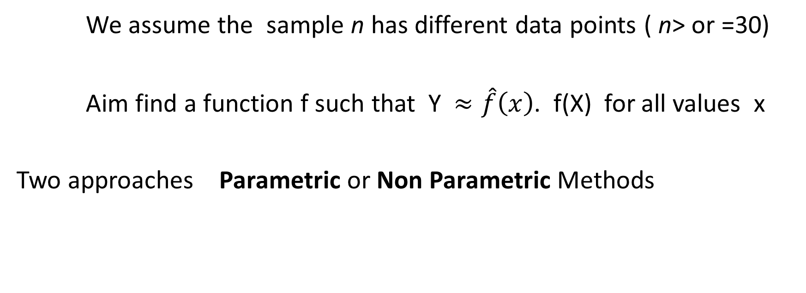
How do we estimate f
We assume the sample n has different data points ( n> or =30)
Aim find a function f such that Y $≈\hat{f}\left(x\right)$. f(X) for all values x
Two approaches Parametric or Non Parametric Methods

Slide 23
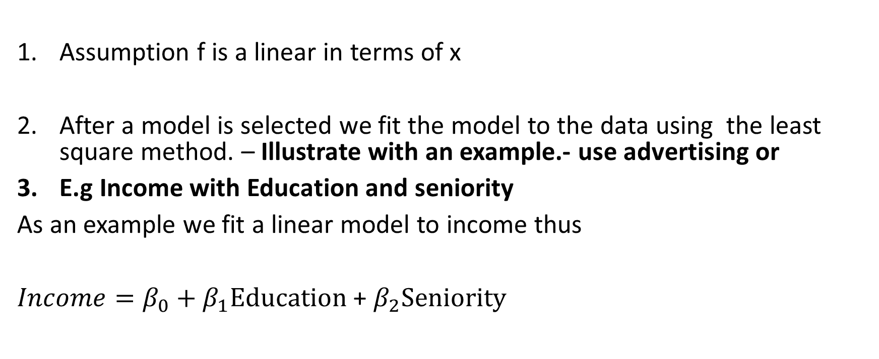
Parametric Methods 2 step model-based approach
Assumption f is a linear in terms of x
After a model is selected we fit the model to the data using the least square method. – Illustrate with an example.- use advertising or
E.g Income with Education and seniority
As an example we fit a linear model to income thus
$Income=β_{0}+β_{1}Education$ + $β_{2}Seniority$

Slide 24
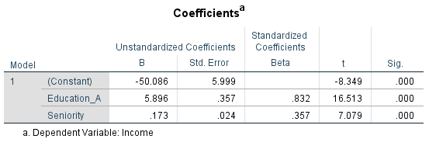

Output from spss $Income=β_{0}+β_{1}Education$ + $β_{2}Seniority$ Income = -50.08 + 5.89Education + 0.173 Seniority

Slide 25
Income data is fitted to a linear equation. observations are displayed in red. Slightly less positive relationship between seniority and income. Model is fitted using the line of best fit (least square method)

Slide 26
Using SPSS or Excel Build this model
Data is stored in week 1 document as an excel file.
Write the equation on this slide once you have built the model.

Slide 27
Non- Parametric Methods.
These methods do not make explicit assumptions about the functional form of f.
Method seeks to find an estimate of f that gets as close to data points as possible without being two rough or wrigley.
Advantage of this method is it avoids the assumption of a particular function form of f. It assumes to accurately fit a wider range of possible shapes for F.
Disadvantage this method does not reduce the problem of estimating as to a small number of parameters. A very large number of observations is required in order to obtain an accurate estimate for F.
These methods will be considered later.

Slide 28
A rough thin spline fit to the Income data This fit makes zero errors on the training data.
Notes:
Note the non parametric fit has produced a remarkably accurate estimate of the truth f as shown in the yellow figure.
A a thin plate spline is used to estimate F. This approach does not impose any pre specified model on f. instead it attempts to produce an estimate for F that is as close as possible to the observed data see yellow graph. However this is an example of overfitting the data. It is an undesirable situation because the fit obtained will not yield accurate estimates on new observations that were not part of the training data set. We will discuss these at a later stage.
. The resulting estimate fits the observed data perfectly. However this spline fit is far more variable than the true function F. The resulting estimate

Slide 29
Trade-off Between flexibility and interpretability, using different statistical methods.
In General, as the flexibility of a method increases, it's interpretability decreases.
Notes:
Why use a more restrictive method instead of a flexible approach?
Reasons include that we may mainly be interested in inference
We may want restrictive models as they are much more interpretable. E.g.the linear model may be good choice since it's easy to understand the relationship between Y and X1, X2 …..XP.
In contrast very flexible approaches such as spine's and the boosting methods can lead two such complicated estimates of x that it is difficult to understand how any individual predictor is associated with the response. Note the least square regression model is relatively inflexible but quite interpretable.

Slide 30
Lecture 1 Bite 2
We will explore the linear models in greater details next week
For practice you may wish to explore the data set on income to find a simple or multiple regression model. Which we can discuss next week

